Slide 1
Submitted By : Sakshee Suryawanshi Sainadh Channamsetty Tanuja Modupalli
“Open-Pit Mine Operation Analysis: Addressing Inefficiencies in Production and Building Trust”

Slide 2
Agenda :
Problem Statement
Data Processing: Procedures
Key Metrics Tracked
Key Insights Derived
Appendix:
Dashboards and Visuals
Data Source
Recommendations & Business Impacts

Slide 3
Problem Statement
The Open Pit mine is facing problems of inefficient production.
As demands are not met, customers' trust is declining. Due to internal inefficiencies, no surge in demand observed.
Operators need detailed tracking and insights of their on-field operations.

Slide 4
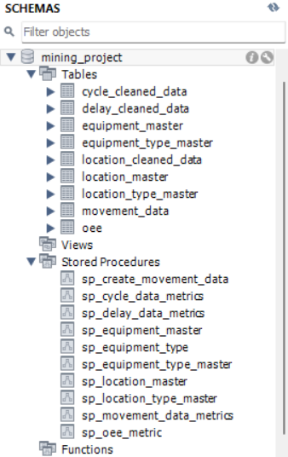
Data Processing : Procedures
Data Cleaning and Preparation.
Created Master Tables (Equipment, Location, Movement).
Prepared Stored Procedures for Data like Cycle, Delay, Movement and OEE Metrics Calculations.
Built Key Metrics: Availability, Performance, Quality, OEE.
Developed Dashboards in Power BI.

Slide 5
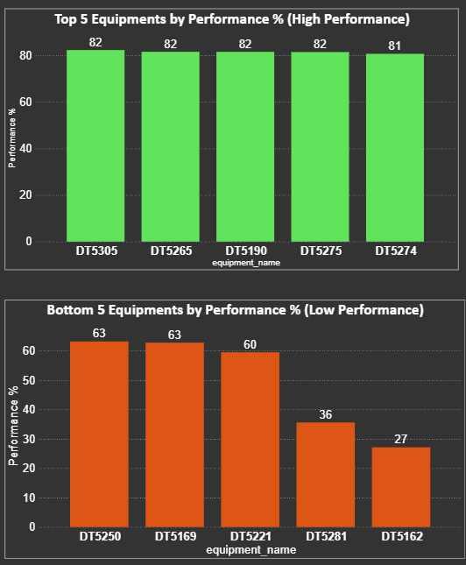
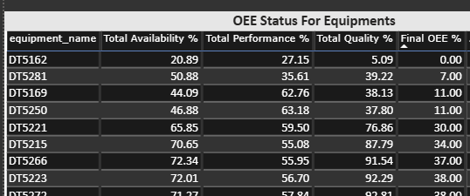
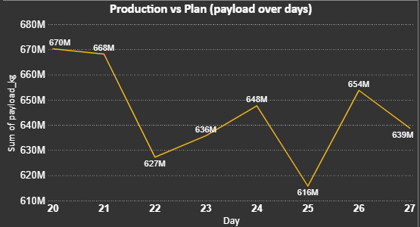
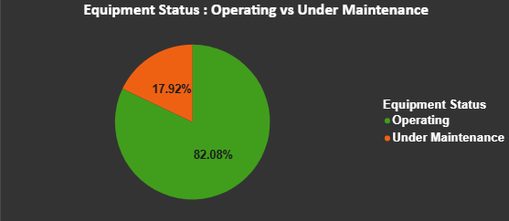
Key Metrics Tracked
Equipment Availability.
Number of Equipment Operating vs Under Maintenance.
Production Rates :
Production vs Plan
Top and Bottom Performing Equipment.
OEE (Availability, Performance, Quality).

Slide 6
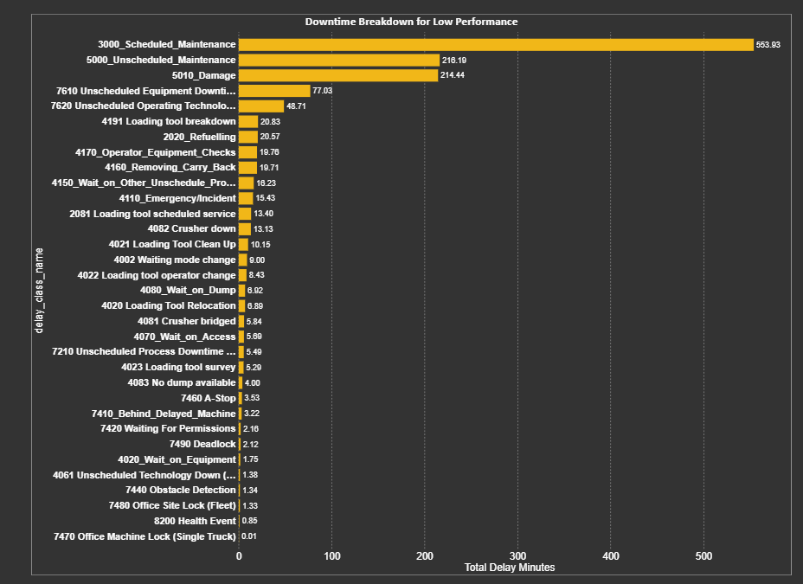
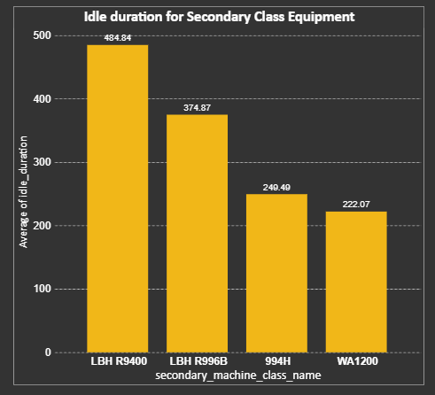
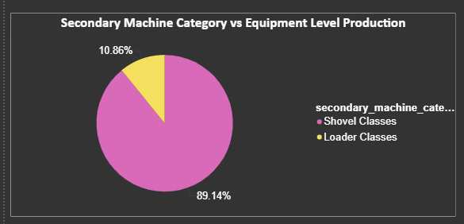
Insights Derived
High downtime in primary machine equipment like “DT5162” followed by “DT5281” and “DT5169” leading to reduced OEE.
The Shovel Class Equipment are more efficient than Loader Class.
The major reason behind high Downtime are “3000 Scheduled Maintenance”, “5000 Unscheduled Maintenance” and “5010 Damage”.
Idle and delay durations is high for Secondary Class equipment “LBH R996B” and “LBH R9400” , which is significantly impacting efficiency.

Slide 7
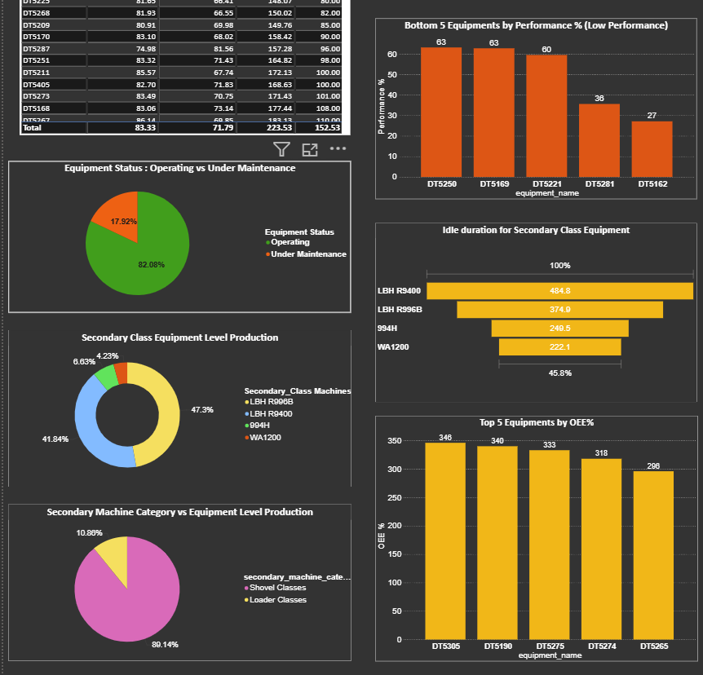
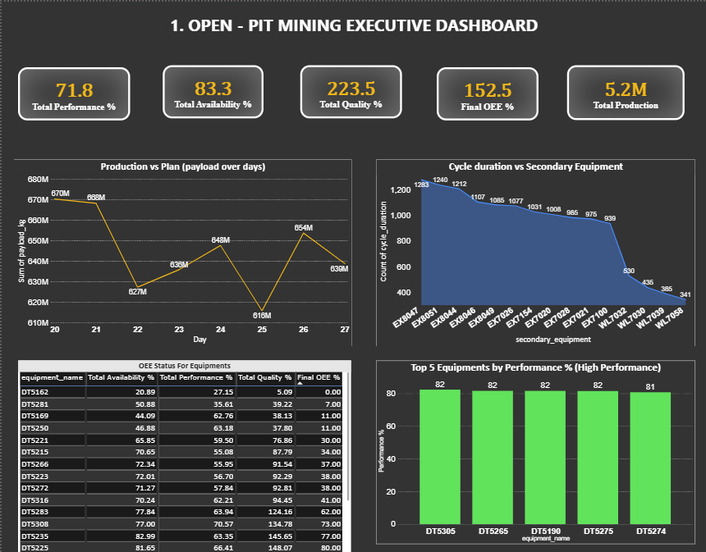
Appendix: Dashboards and Visuals

Slide 8
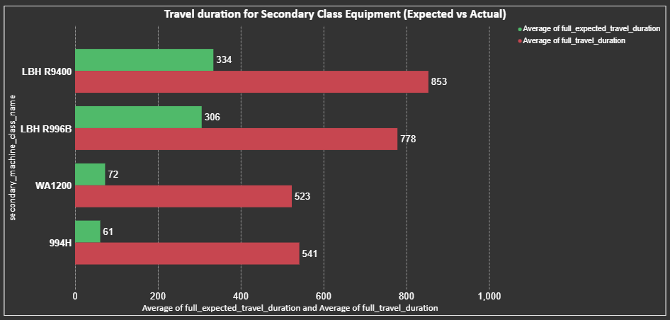
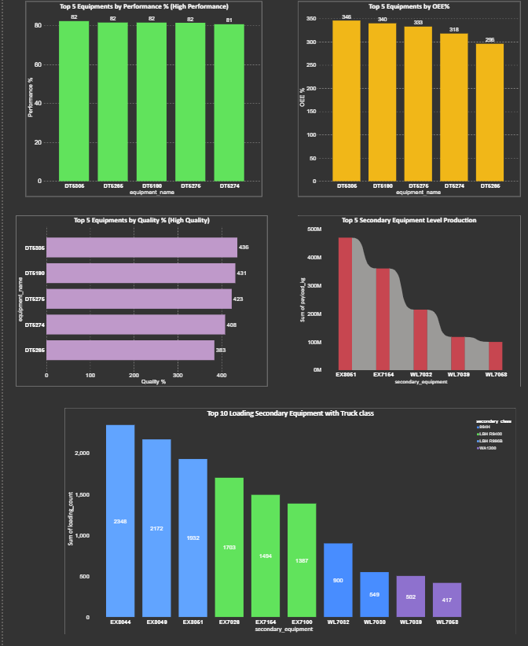
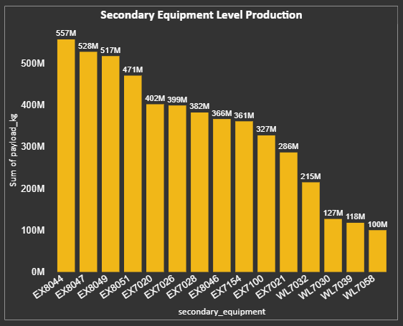
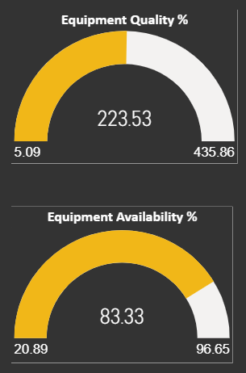
Appendix: Dashboards and Visuals

Slide 9
Appendix : Data Source
Cycle Data: Equipment operations and payload.
Delay Data: Downtime and reasons for delays.
Location Data: Movements and locations.
Derived Movement and OEE Metrics (from Cycle Data).

Slide 10
Appendix : Recommendations
Focused Maintenance Strategy :
Focus maintenance for poor equipment with consistently low OEE and implement predictive maintenance model.
Outcome: Reduced unplanned downtime, better fleet reliability.
Optimize Scheduling to Reduce Idle & Queuing Times :
Reduce idle and queuing times through better scheduling and continuous monitoring with live dashboards.
Outcome: Higher throughput, faster ore movement.
Operator Training & Performance Uplift
Conduct regular training sessions focused on loading/unloading efficiency and highlight top-performing operators/equipment.
Outcome: Standardized operations, reduced human-driven inefficiencies.

Slide 11
Appendix : Business Impacts
Improved OEE and production reliability.
Stronger customer trust due to consistent order fulfillment.
Reduced operational costs from fewer breakdowns and optimized utilization.
Ultimately, higher profitability and long-term sustainability for the mine.

Slide 12
Thank You

